Slide 1
Great Invention
Author: Dmitry Tikhonov, MIPT student

Slide 2
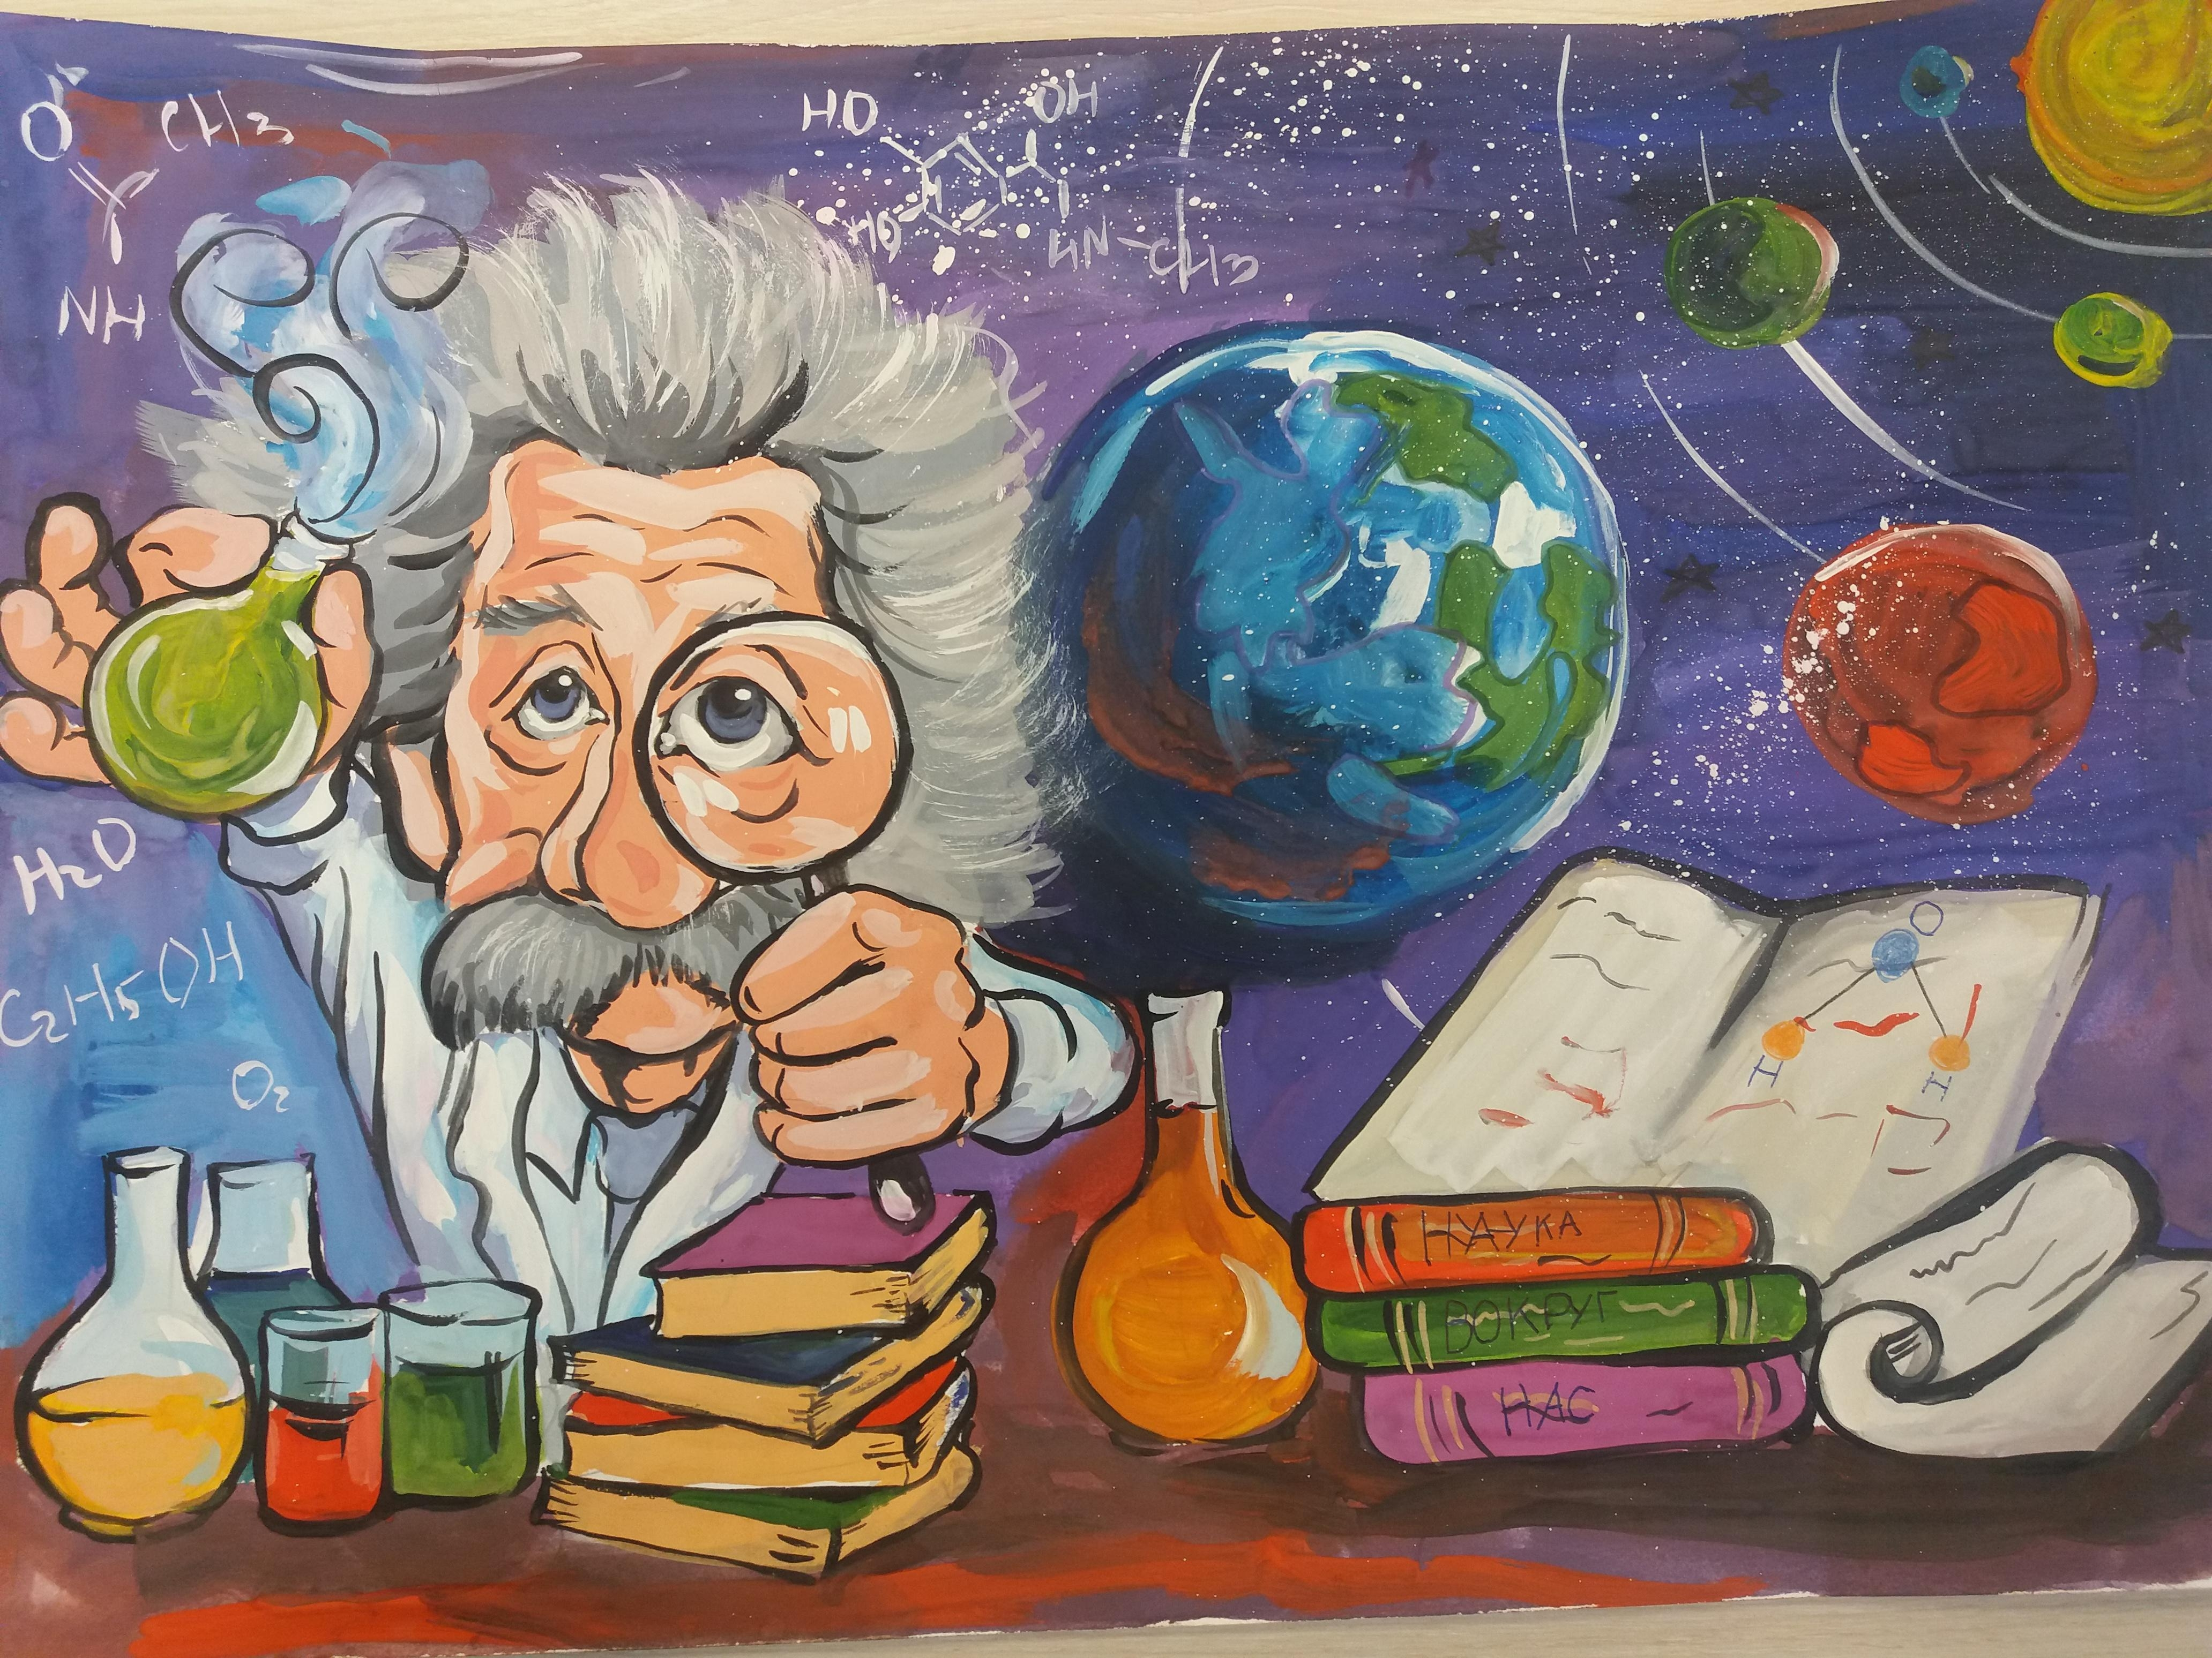
The world of science has no borders

Slide 3

The invention of Zhores Alferov

Slide 4
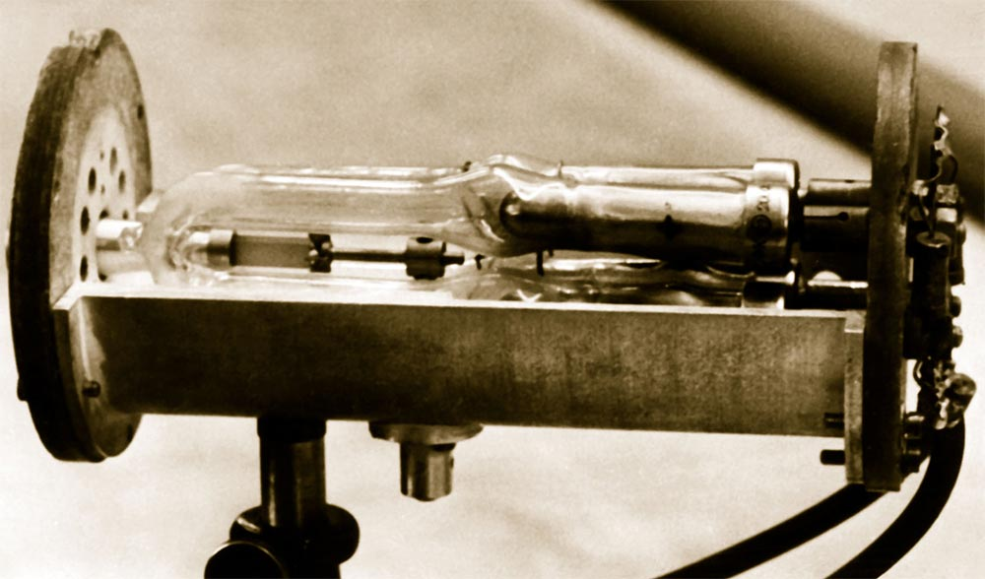
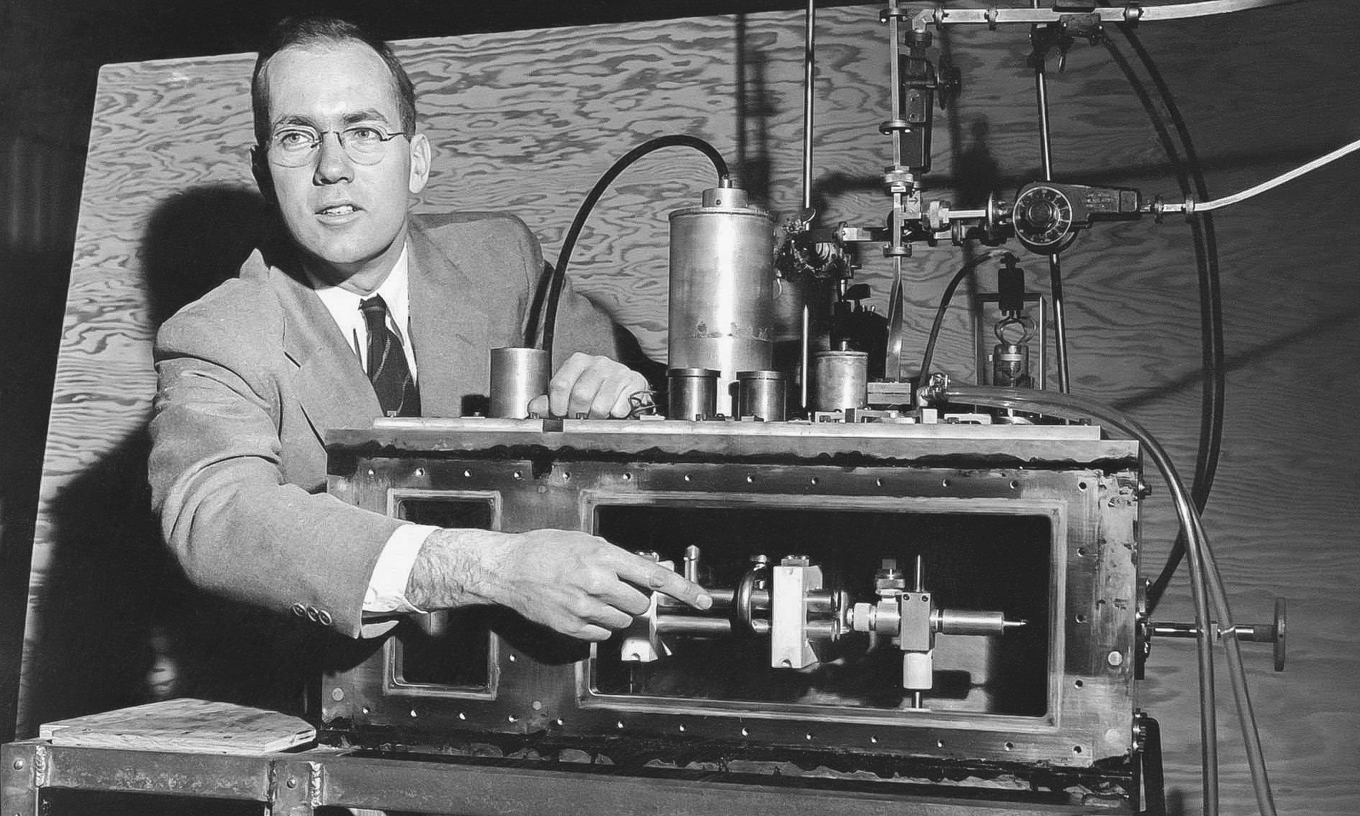
Disadvantages of the first lasers

Slide 5
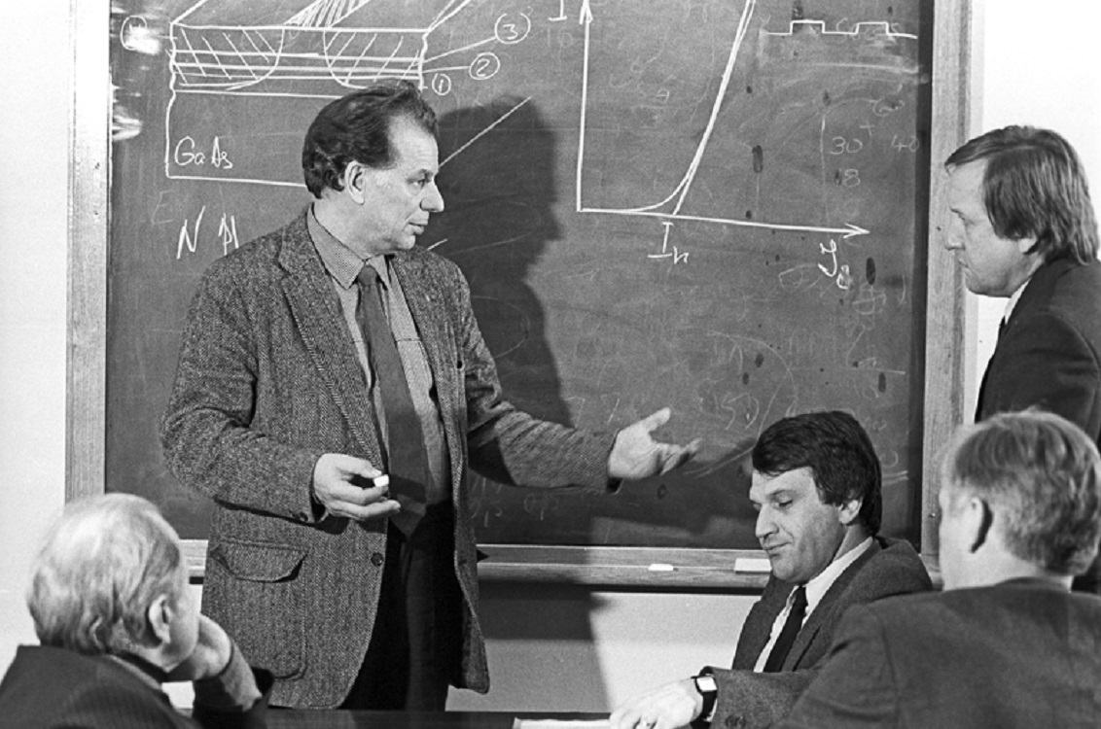
Alferov's brilliant idea

Slide 6
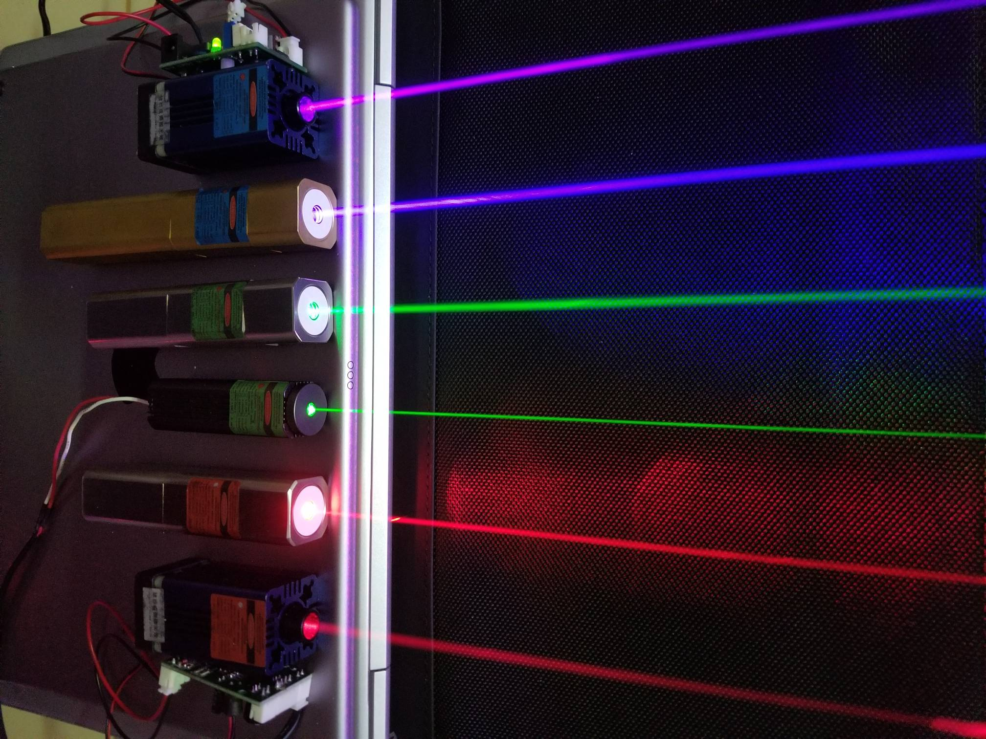


Alferov's contribution to science and people's lives

Slide 7
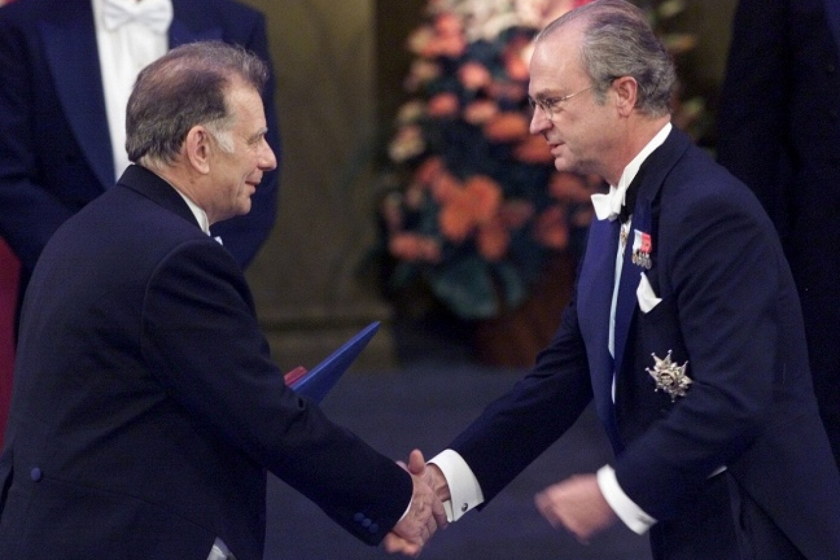
Nobel prize

Slide 8
Thank you for your attention!

Slide 9
References to the literature used
https://nplus1.ru/ – Popular science publication «N+1»
https://ru.wikipedia.org/wiki - «Wikipedia»
https://urfodu.ru/ww/en/experts/zhores_alfyerov/ - Biography of Zhores Alferov

